Slide 1

PROJECT ON RESTAURANT
SUBMITTED BY:-
REG. No. | NAME | ROLL NO.
11707602 | SATYAVARDHAN | A04
11707034 | KANCHAN | A05
11707506 | SUKHVANT SINGH | A06
SECTION- K17QS
SUBJECT- INTERNET PROGRAMMING

Slide 2
INTRODUCTION
The project is about making the restaurant website which consist of table booking and order food and also about restaurant terms and condition.

Slide 3
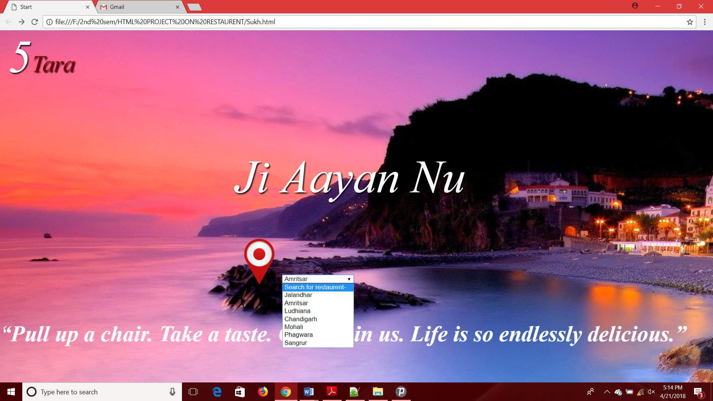
PROFILE PAGE
This page is the profile page of the website which has location details of the restaurant

Slide 4
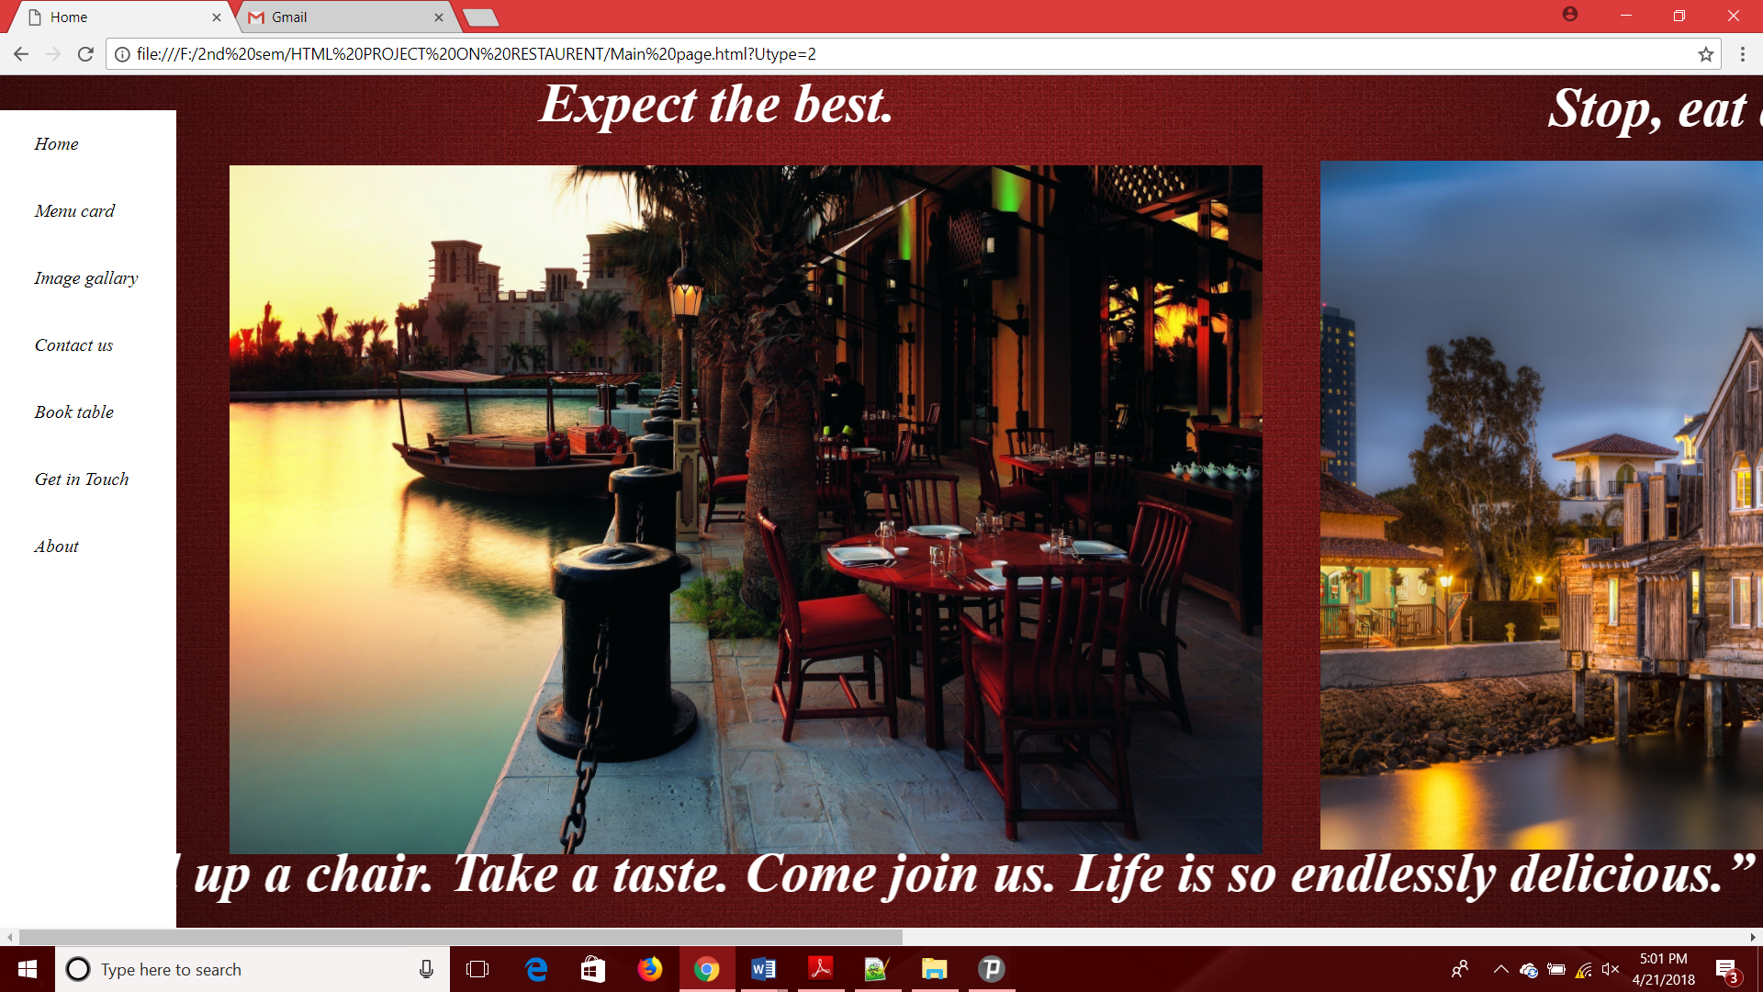
MAIN PAGE
This page is the main page of the website which has home, menu card, image gallery, table booking, contact details and contain all the functionality of the website.

Slide 5
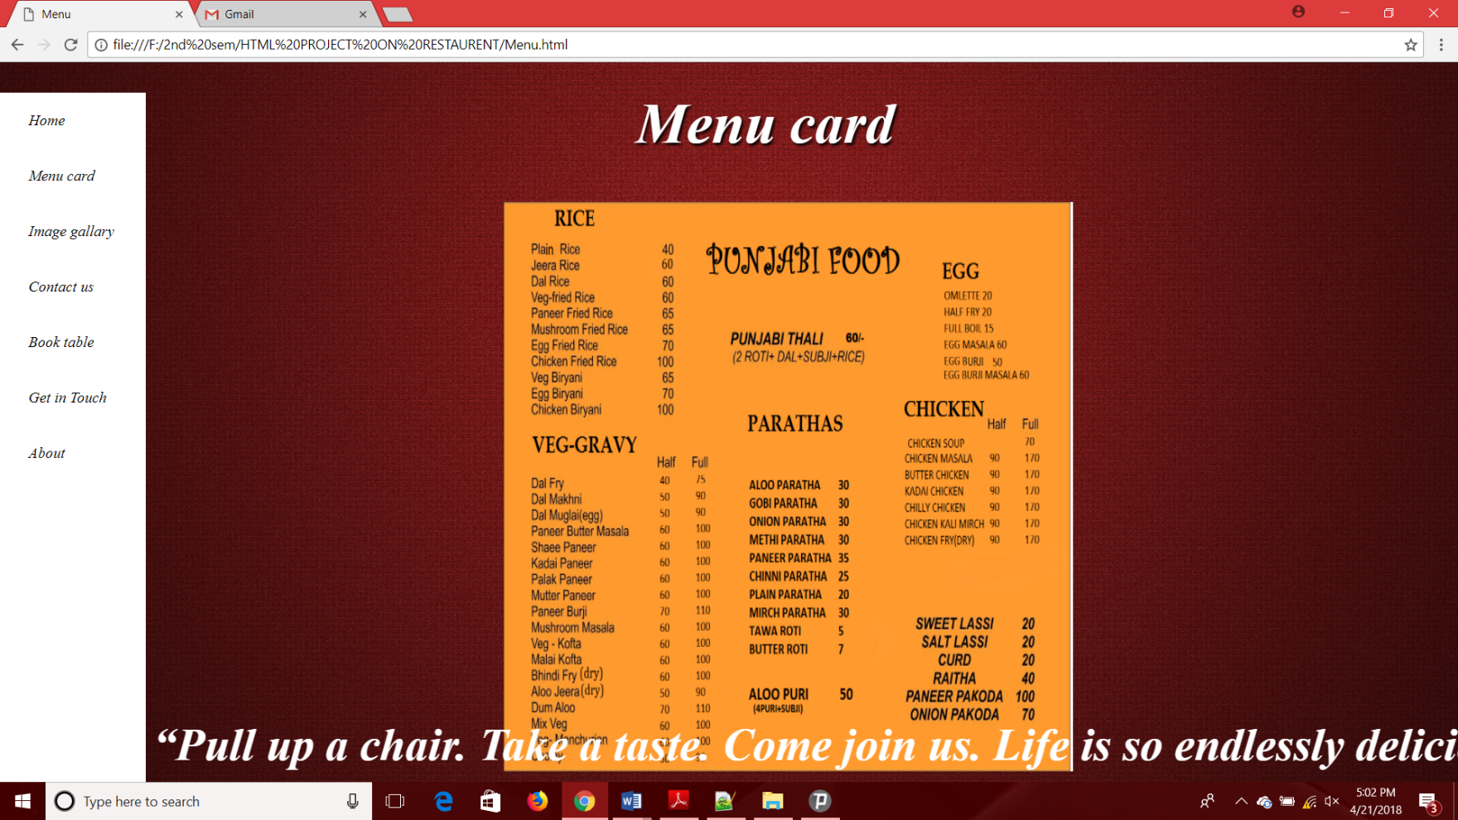
MENU CARD
This page is the menu card page of the website and also contain all the functionality of the website.

Slide 6
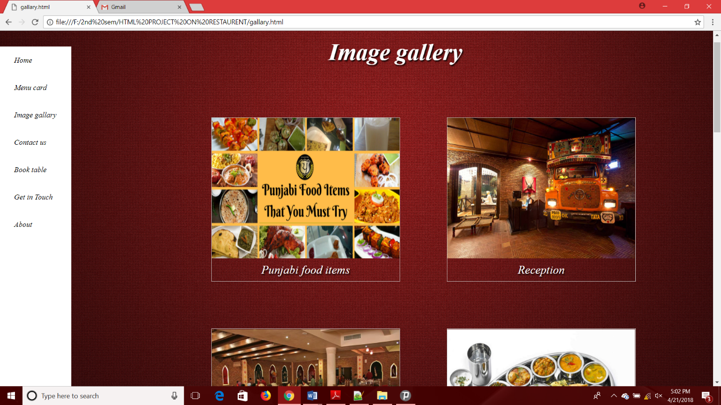
IMAGE GALLARY
This page is the image gallary page of the website and also contain all the functionality of the website.

Slide 7
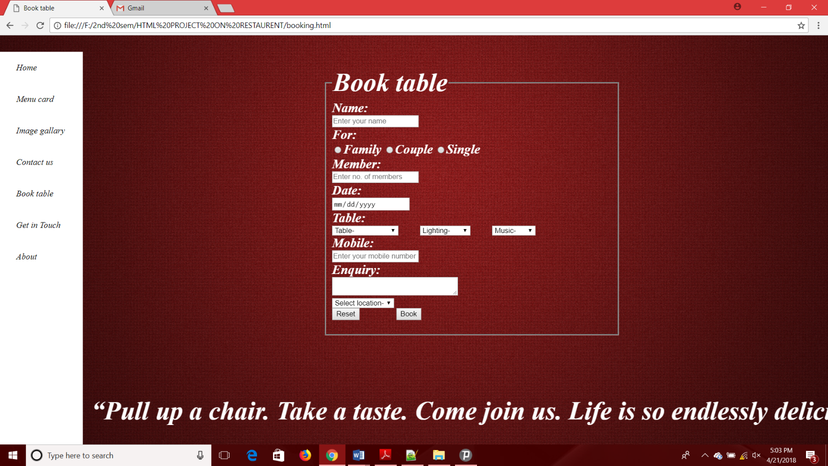
BOOK TABLE
In this page user can select the table according to his need.

Slide 8
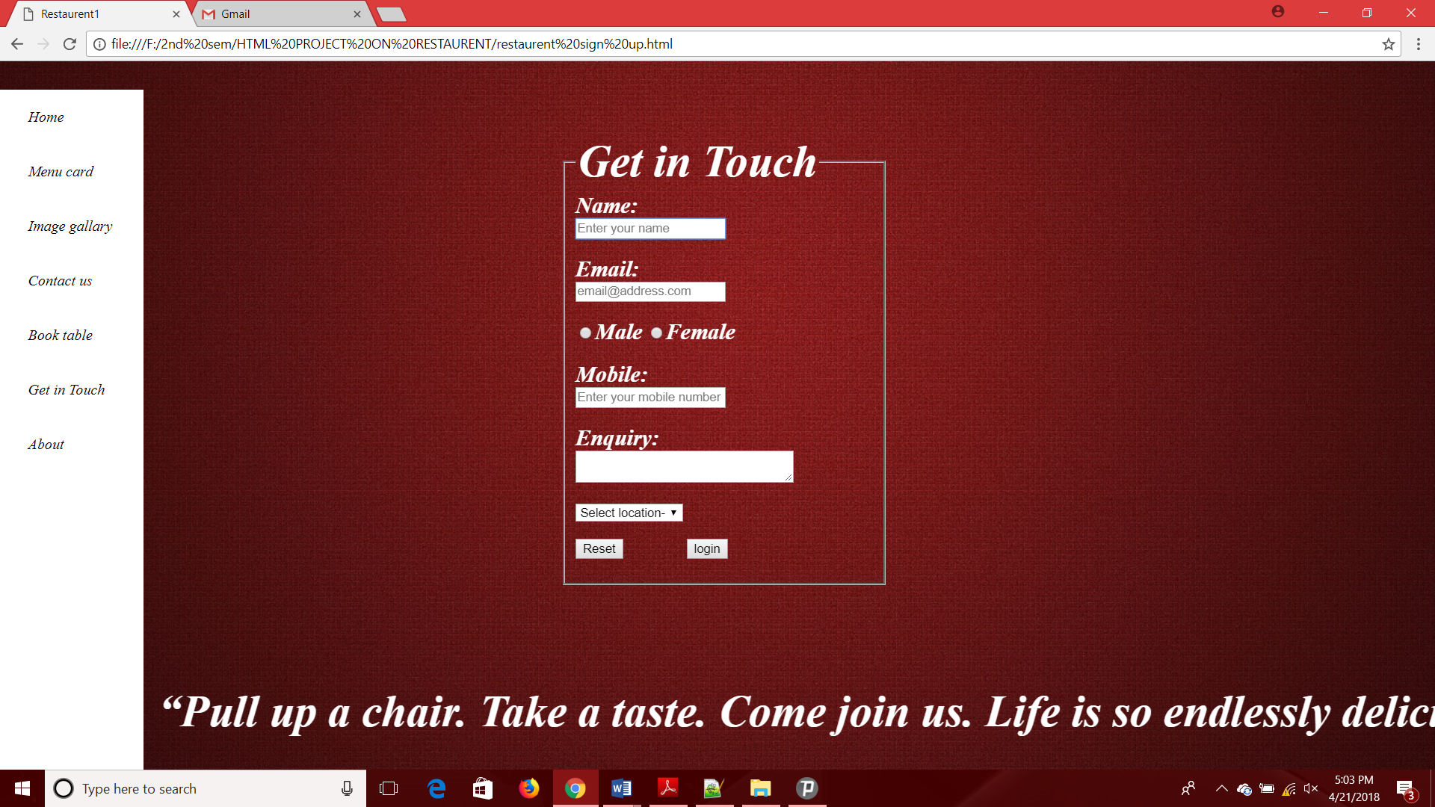
LOGIN PAGE
In this page user can login in this website.

Slide 9
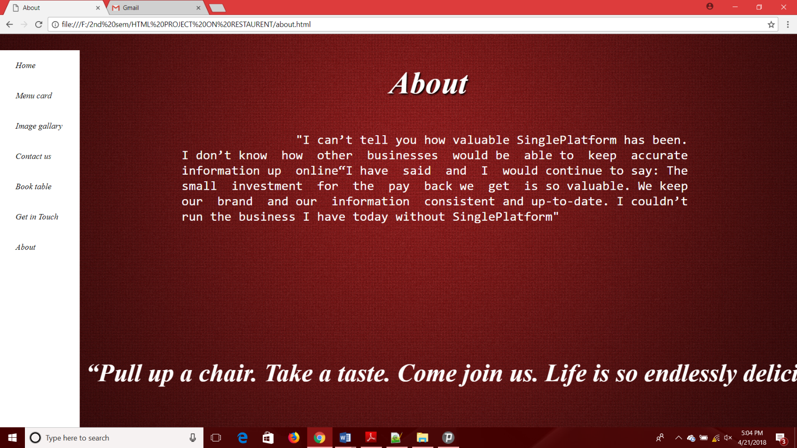
ABOUT
This page contain the information about restaurant.

Slide 10
CONCLUSION
When we were making this project we have learnt about the basic coding.it was very interesting to code HTML, JS and CSS. We know the use of this language in the field of computer science.so we gave our full attention on it.

